Slide 1
Web API
Application Programing Interface

Slide 2
Topic
What is Web api
Web API components
How web api works
Data Formats
Cross-Origin Resource Sharing (CORS)
Assignment

Slide 3
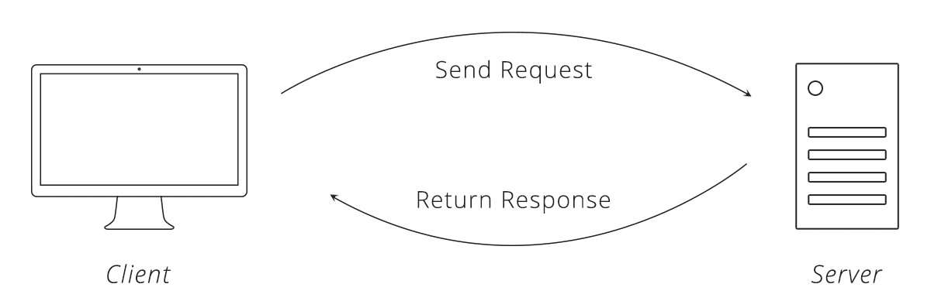
What is Web api
Web API is a framework for building HTTP services that can be consumed by a broad range of clients including browsers, mobiles, iphone and tablets.
Web API is the great framework for exposing your data and service to different-different devices.

Slide 4
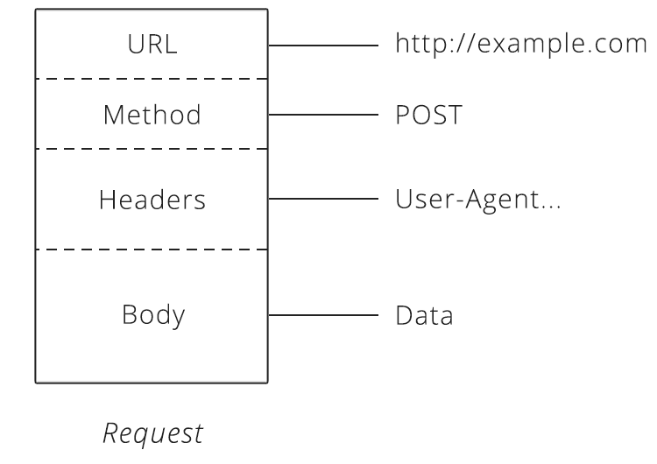
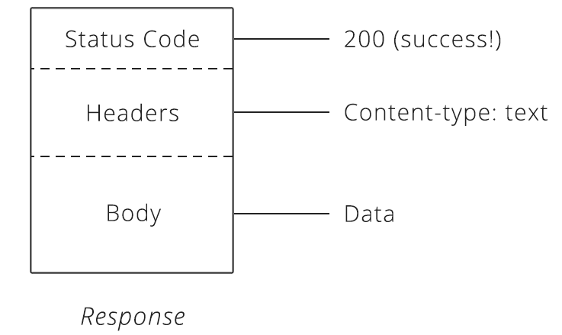
Web API components
HTTP Request
HTTP Response

Slide 5
Web API components
URL
URLs become an easy way for the client to tell the server which things it wants to interact with, called resources.
Method
The method request tells the server what kind of action the client wants the server to take in. The four most commonly seen in API’s are:
GET — Asks the server to retrieve a resource. POST — Asks the server to create a new resource. PUT — Asks the server to edit/update an existing resource. DELETE — Asks the server to delete a resource.
Headers
Headers provide meta-information about a request.
Body
The request body contains the data the client wants to send the server.
Status code
Status code are three-digit numbers.

Slide 6
HTTP VERB / Http method
HTTP GET
to retrieve resource representation/information only
HTTP POST
to create new subordinate resources,
HTTP PUT
to update existing resource
HTTP DELETE
to delete resources
HTTP PATCH
to make partial update on a resource

Slide 7
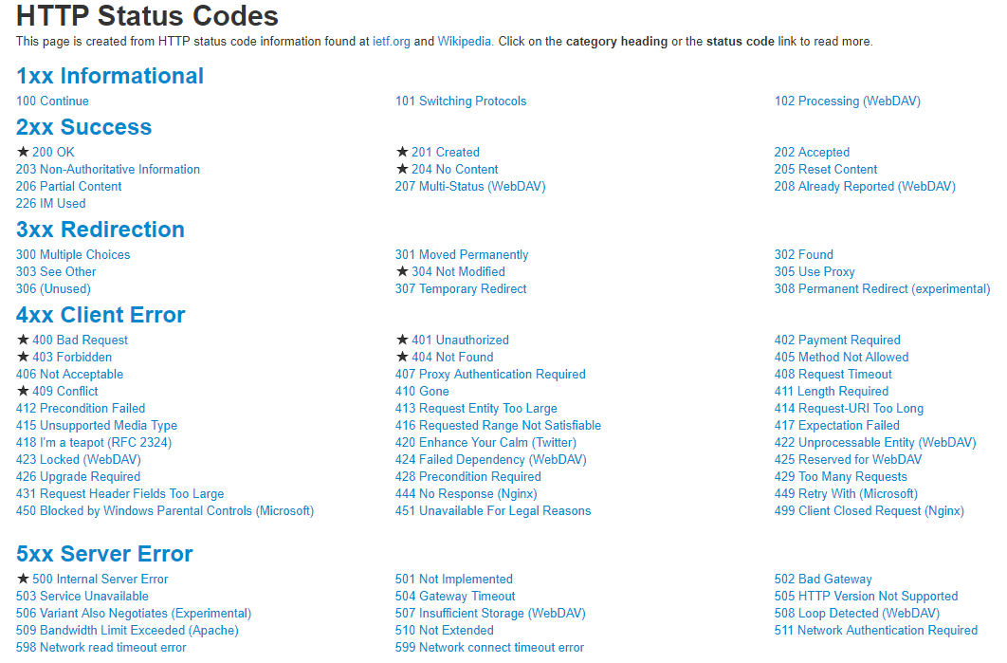
Http Status code
https://www.restapitutorial.com/httpstatuscodes.html#

Slide 8
Http Status code
HTTP Verb | CRUD | Entire Collection (e.g. /customers) | Specific Item (e.g. /customers/{id})
POST | Create | 201 (Created), 'Location' header with link to /customers/{id} containing new ID. | 404 (Not Found), 409 (Conflict) if resource already exists..
GET | Read | 200 (OK), list of customers. Use pagination, sorting and filtering to navigate big lists. | 200 (OK), single customer. 404 (Not Found), if ID not found or invalid.
PUT | Update/Replace | 405 (Method Not Allowed), unless you want to update/replace every resource in the entire collection. | 200 (OK) or 204 (No Content). 404 (Not Found), if ID not found or invalid.
PATCH | Update/Modify | 405 (Method Not Allowed), unless you want to modify the collection itself. | 200 (OK) or 204 (No Content). 404 (Not Found), if ID not found or invalid.
DELETE | Delete | 405 (Method Not Allowed), unless you want to delete the whole collection—not often desirable. | 200 (OK). 404 (Not Found), if ID not found or invalid.
https://www.restapitutorial.com/lessons/httpmethods.html

Slide 9
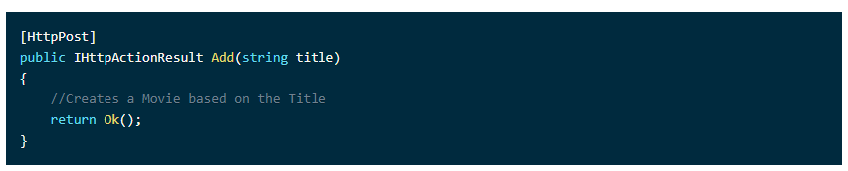
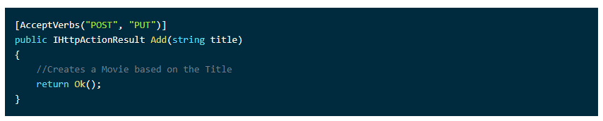
example

Slide 10
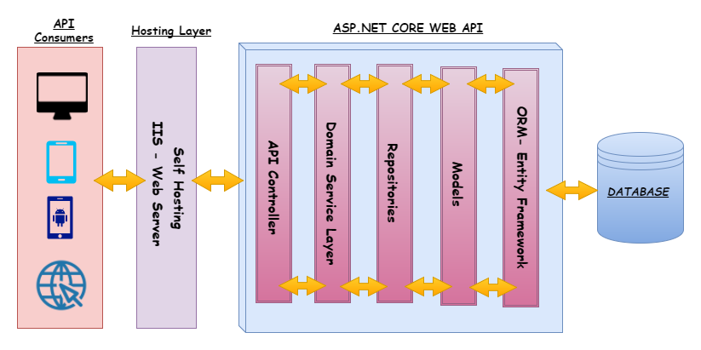
How web api works

Slide 11
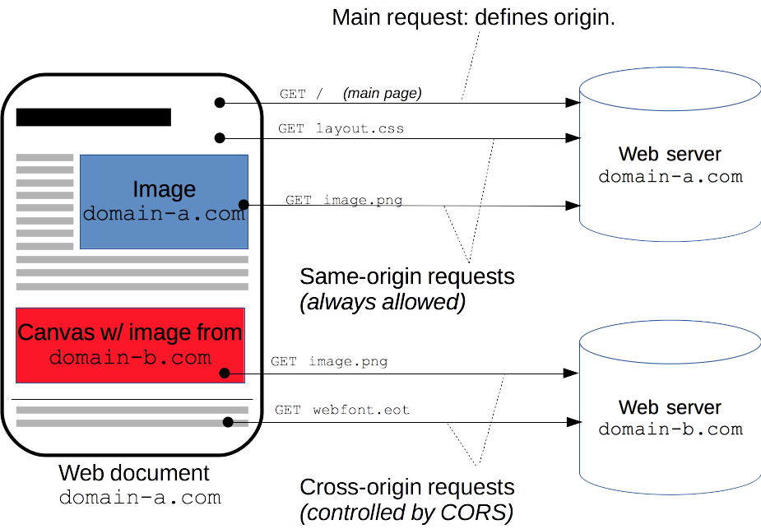
Cross-Origin Resource Sharing (CORS)
Cross-Origin Resource Sharing (CORS) is a mechanism that uses additional HTTP headers to tell a browser to let a web application running at one origin (domain) have permission to access selected resources from a server at a different origin

Slide 12
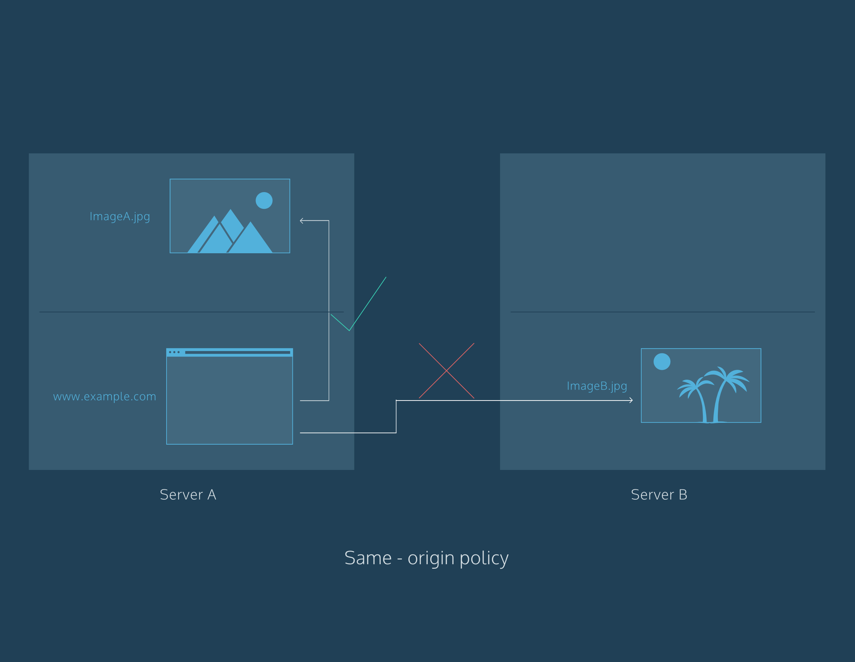

Cross-Origin Resource Sharing (CORS)

Slide 13
Cross-Origin Resource Sharing (CORS)
Install-Package Microsoft.AspNet.WebApi.Cors
App_Start/WebApiConfig.cs. Add the following code to the WebApiConfig.Register
config.EnableCors();
https://docs.microsoft.com/en-us/aspnet/web-api/overview/security/enabling-cross-origin-requests-in-web-api

Slide 14

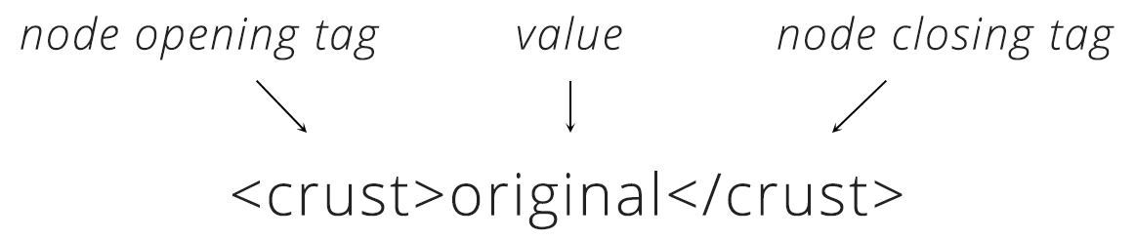
Data Formats
The most common formats found in APIs are JSON and XML.
JSON is very simple format that has two pieces: key and value.
XML provides a few building blocks. The main block is called a node. XML always starts with a root node, inside there are more “child” nodes. The name of the node tells us the attribute of the order and the data inside is the actual details.

Slide 15
assignment
Create Project web api
Create Controller that contain method for GET, POST, PUT, DELETE

